Slide 1
Git, in graphic form
Lecture 14
Oct 22, 2010

Slide 2
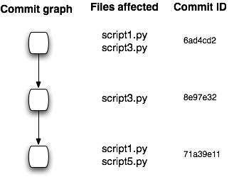
Change tracking basics

Slide 3
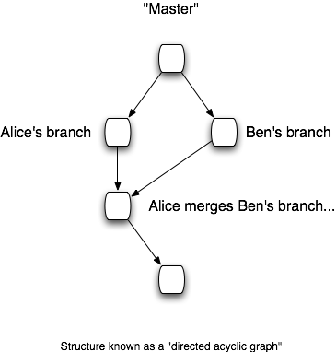
Branching and merging

Slide 4
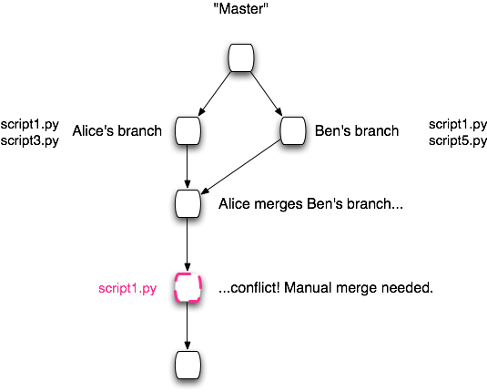
Conflicts

Slide 5
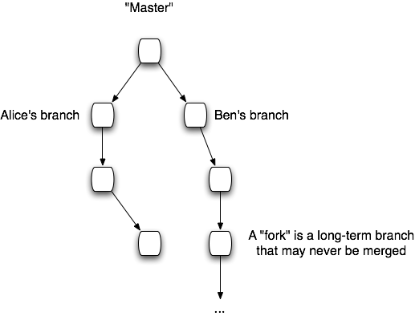
“Forking” vs branching

Slide 6
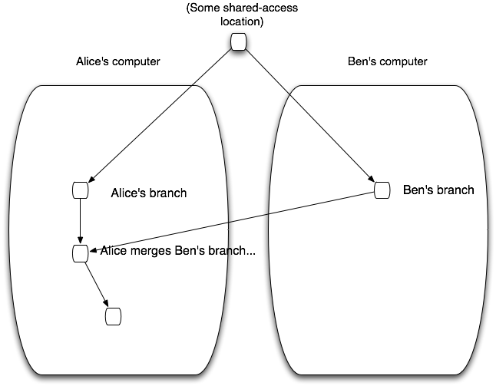
Communicating between repositories

Slide 7
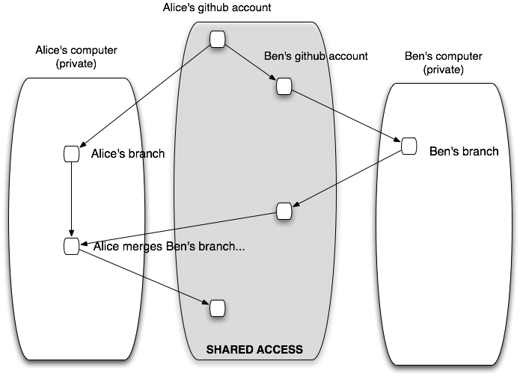
Using github as a communications hub

Slide 8
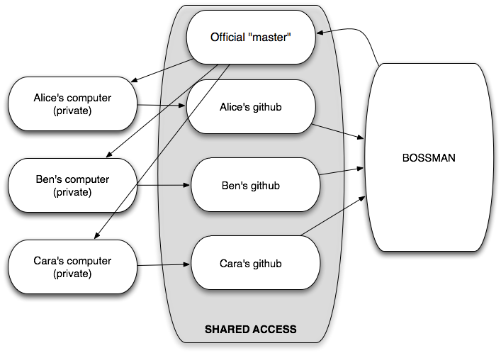
Social policies for actual project management!

Slide 9
A mini-tutorial

Slide 10
A tour of github

Slide 11
Setting up github
Cloning & pulling from github is easy.
…setting it for pushes is not so easy.
This will be a separate lecture…
…but I’m happy to show people how to do it, individually.
(It uses the same kind of ‘key’ auth system that EC2 uses)

Slide 12
Using git in the meantime
Use the ‘git init’, ‘git add’, ‘git commit’, etc.
Copy the entire directory toa rented hard disk, or save it on your laptop.
Copy it back… tada.

